Slide 1
welcome to introduction
To computing project.
It’s Game Development Project.
Made by Siddhesh Kanawade by following tutorial from Tech With Kim YouTube channel.
Link: https://www.youtube.com/channel/UC4JX40jDee_tINbkjycV4Sg

Slide 2

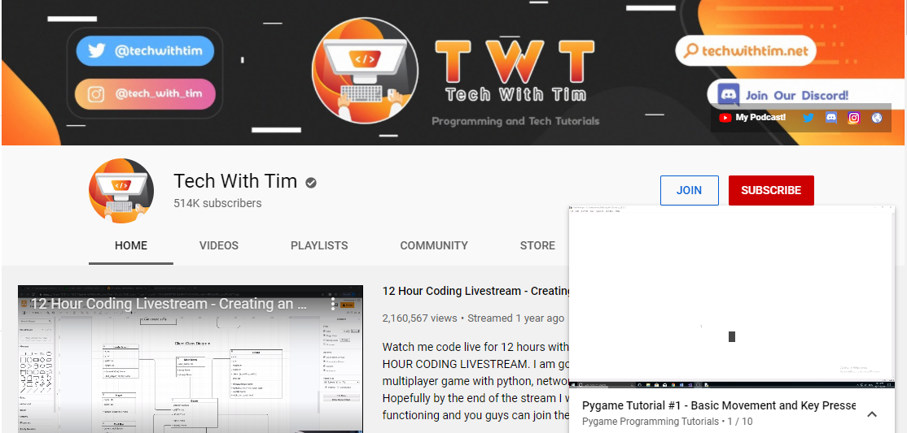
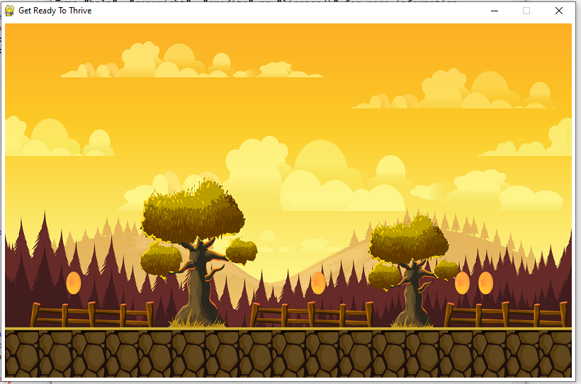
References…
Enemy sprite: https://www.simplifiedpython.net/pygame-sprite-animation-tutorial/
Tutorial from Tech With Tim YouTube channel using the playlist Pygame Programming Tutorial.
Background image: https://s3.amazonaws.com/gameartpartnersimagehost/wp-content/uploads/2018/03/Game_Background_190.png

Slide 3
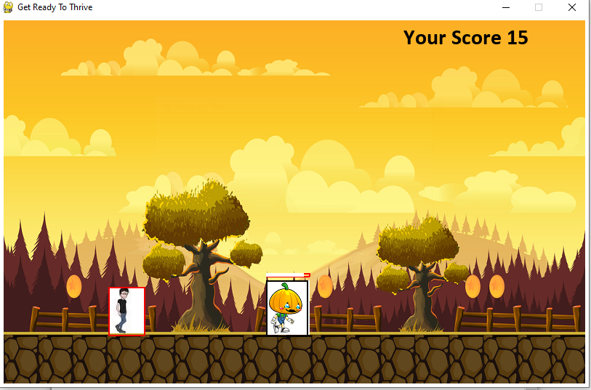
Concept involved…
It’s a single player game named as “Get Ready To Thrive”.
The game consist of two characters- our hero Nobita, the fascinating character from cartoon series Doremon and the Thor from movie science fiction movie Avengers produced by marvel productions.
Nobita is a warrior and has bullets as his weapons and Thor has ability to move very fast and has poison on body, as warrior comes near to villain, he looses some health.
And if Thor is strike by bullet the he looses his health.
The war begins…

Slide 4
Tools and dimensions.
Tools:
The game is coded using the concept of Object Oriented Programming.
I have preferred this as it save the attributes and method and makes long codes look well structured.
The library used is Pygame.
Dimensions:
The window size is 800 X 500.
Both sprites are of 60 X 75.

Slide 5
Basic blueprint of the game…
Developed hero: Nobita.
Wrote code to move and jump Nobita.
Developed enemy: Thor.
Made Nobita shoot bullets.
Made Thor affected by bullets.
Drawn health bar and published score board.

Slide 6
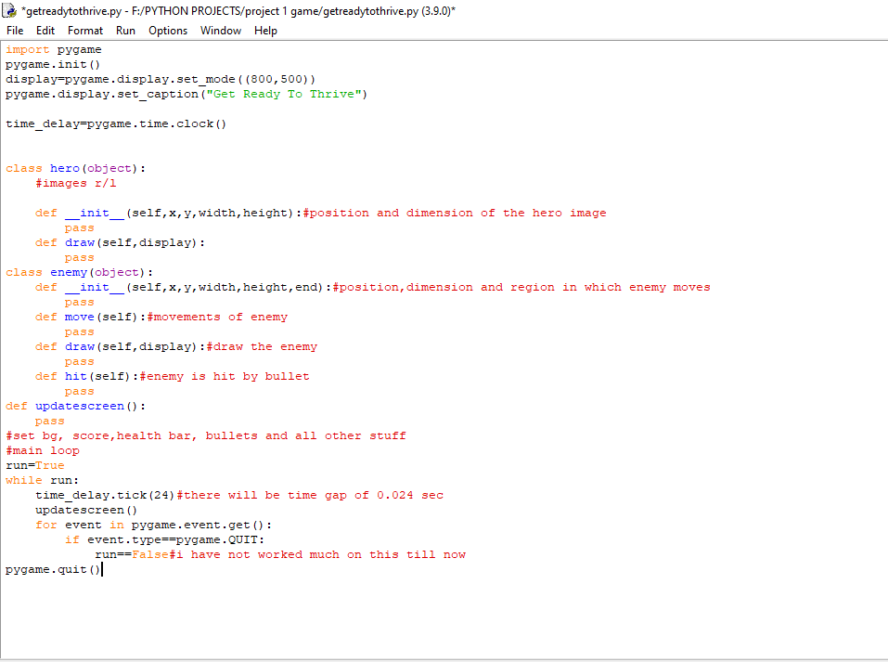

Slide 7
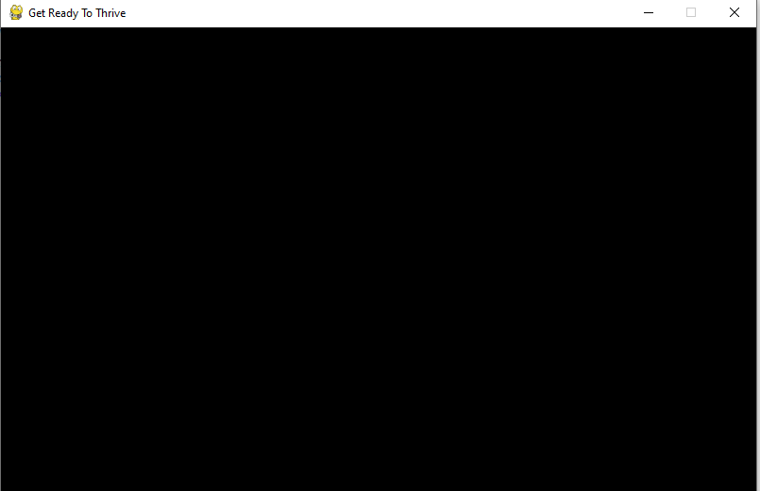



Stages of project building…
Window
Background

Slide 8
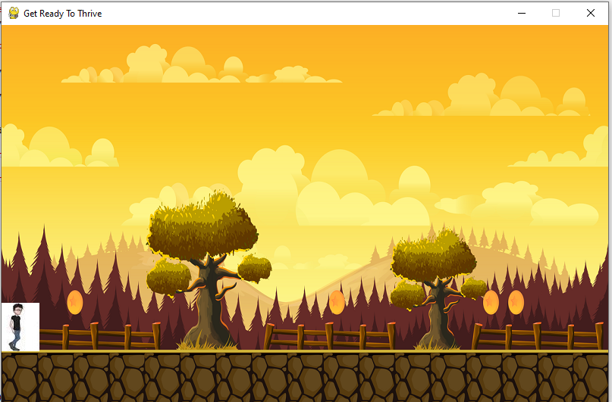
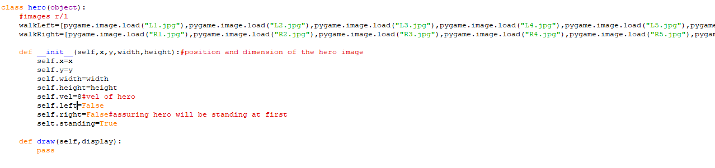
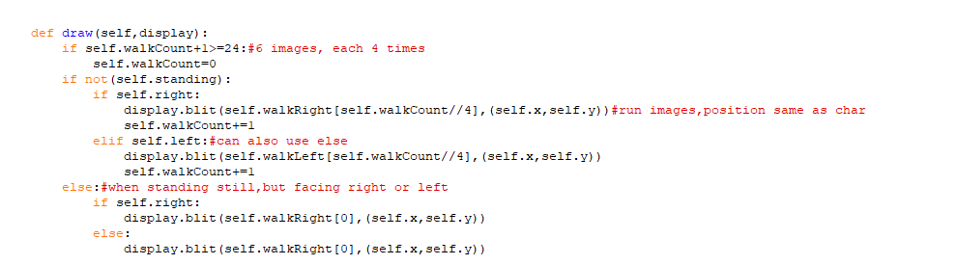

Stages of project building…
Creating Nobita

Slide 9
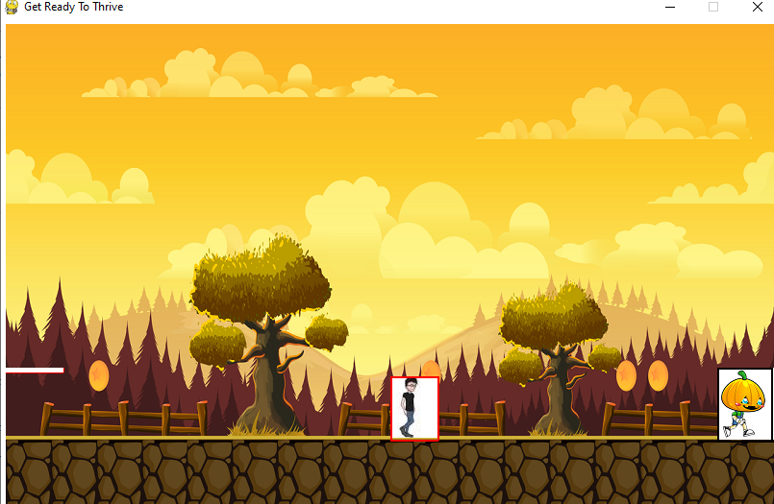
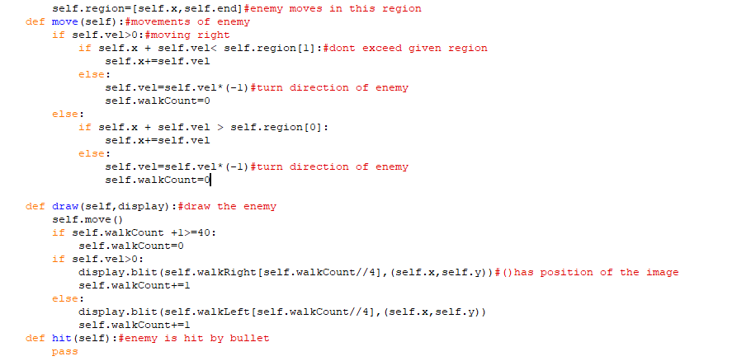
Stages of project building…
Moving Thor

Slide 10
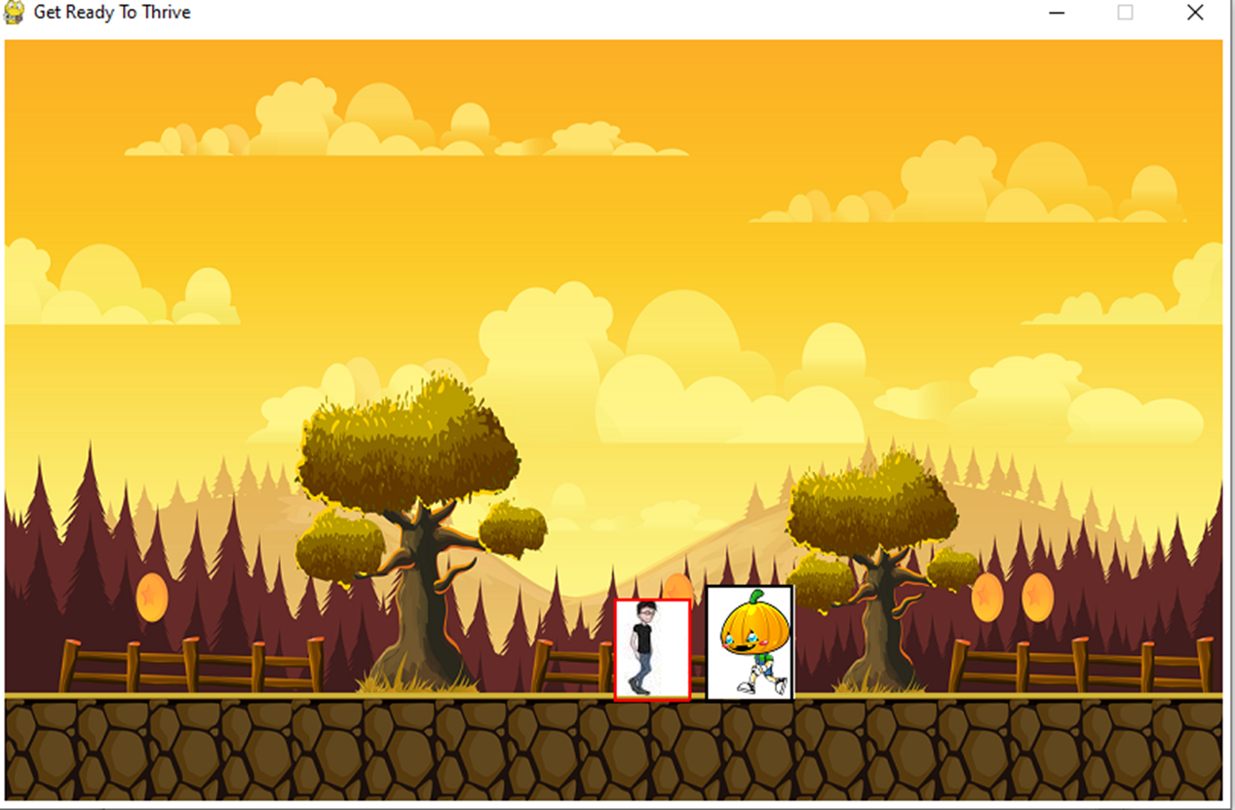
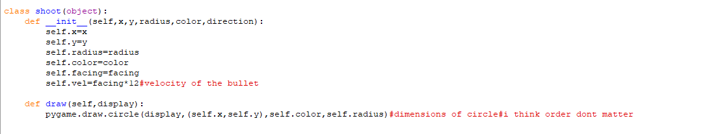
Stages of project building…
Shooting bullets

Slide 11
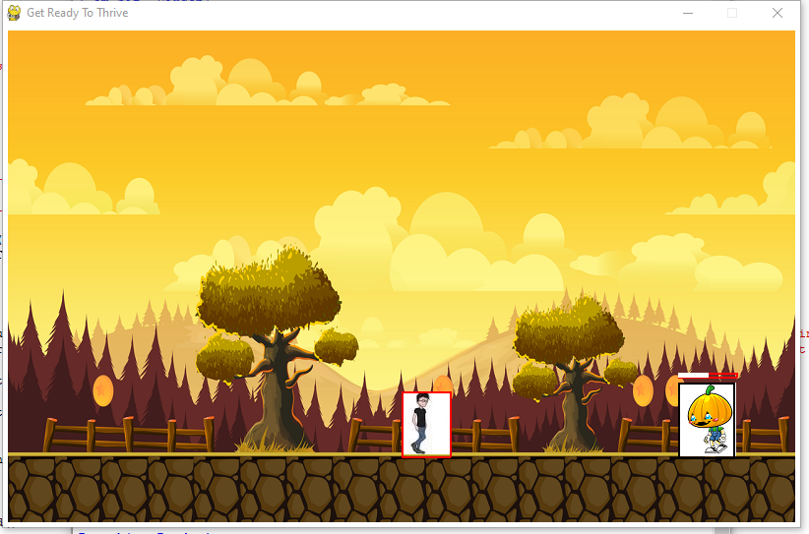
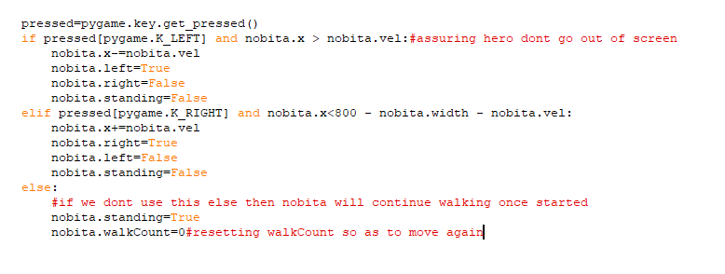
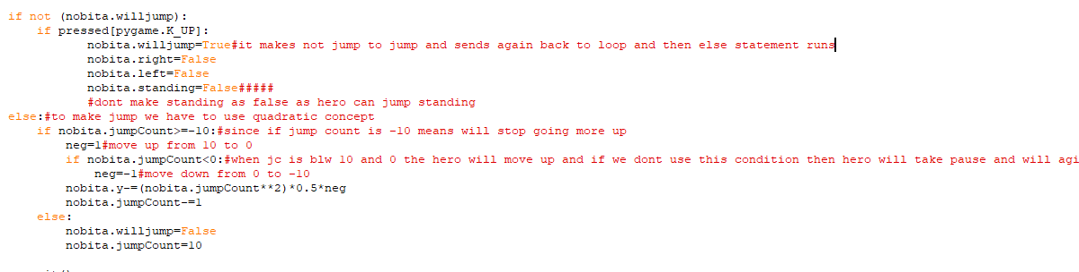
Stages of project building…
Hero walk and jump

Slide 12
Stages of project building…
Making hero jump.
Creating health bars and status.
Displaying score.
Making Thor die.
Final look

Slide 13
Improvements…
Making hero die due to villain.
Giving hero some health.
Adding timer and dashboard to the game.
Developing a welcome window.
Add sound and animation.

